Slide 1
Steel Image Segmentation
SAM
23-06-28

Slide 2
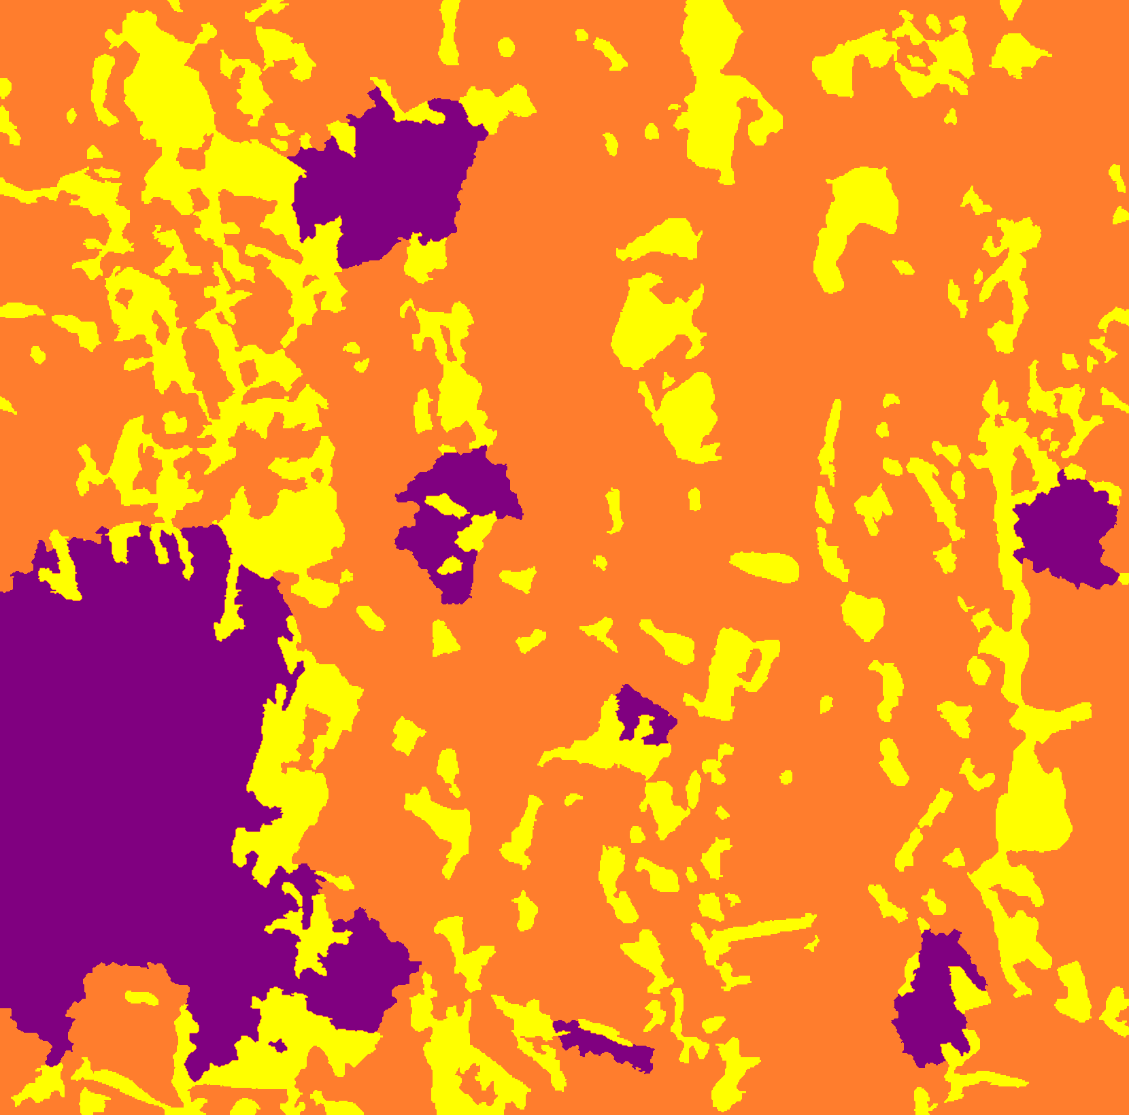
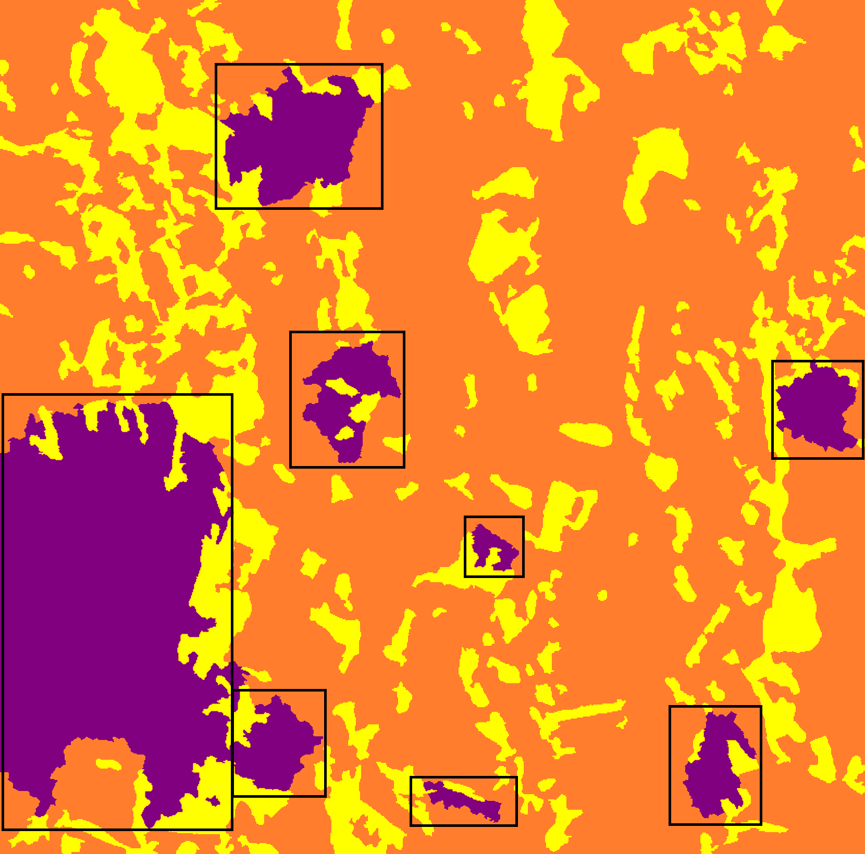
Finding Patterns?
By adding bounding boxes for regions, it makes easy for the SAM to detect these regions and make more accurate predictions. I think this can be done for the hard to detect problems or alternatively we can do this labelling for all classes.

Slide 3
Advantages
It helps the model focus better on certain regions instead of trying to find everywhere in the image.
In implementation, the model will do a 2 tier task.
In the first tier, it will find the regions like the bounding boxes
In second tier, it will perform pixel wise classification on the specific areas
It can help improve the accuracy by only classifying a certain class in side a given boundary.

Slide 4
Disadvantages
Finding the bounding box itself might be difficult task

